Slide 1
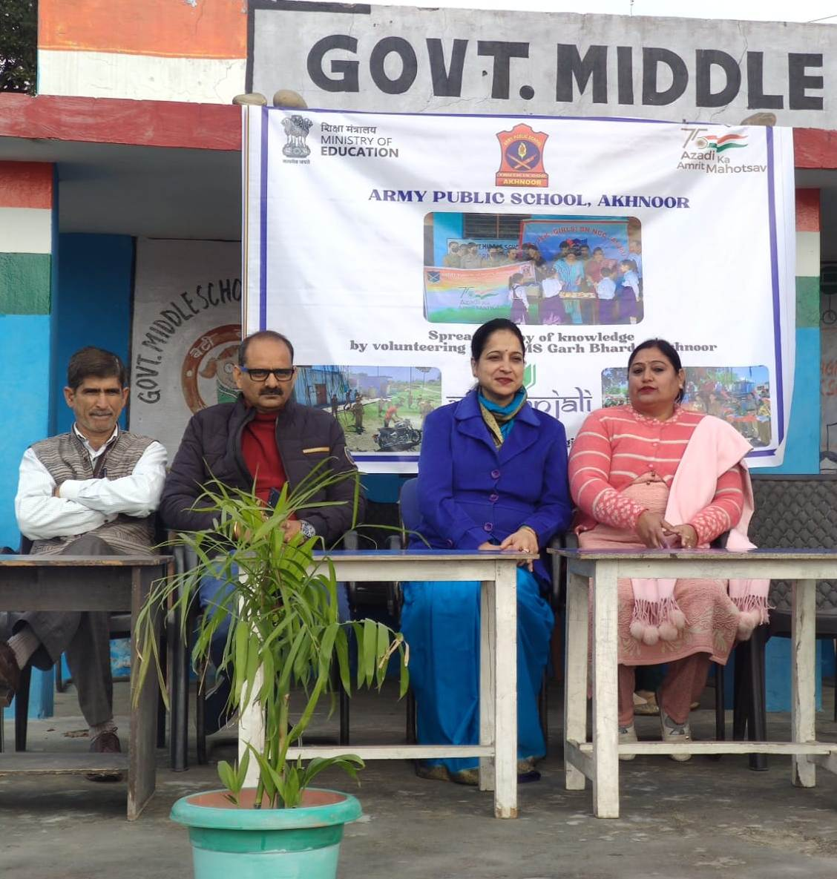
VISIT AT GMS GARH BHARDA UNDER VIDYANJALI PROGRAMME

Slide 2
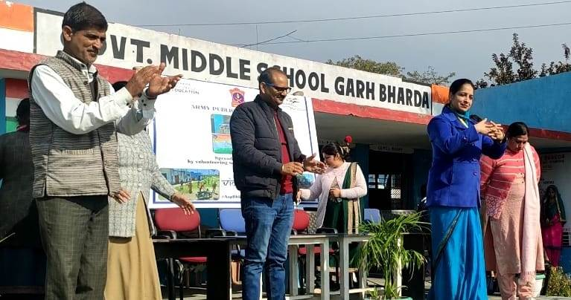
VISIT AT GMS GARH BHARDA UNDER
VIDYANJALI PROGRAMME

Slide 3
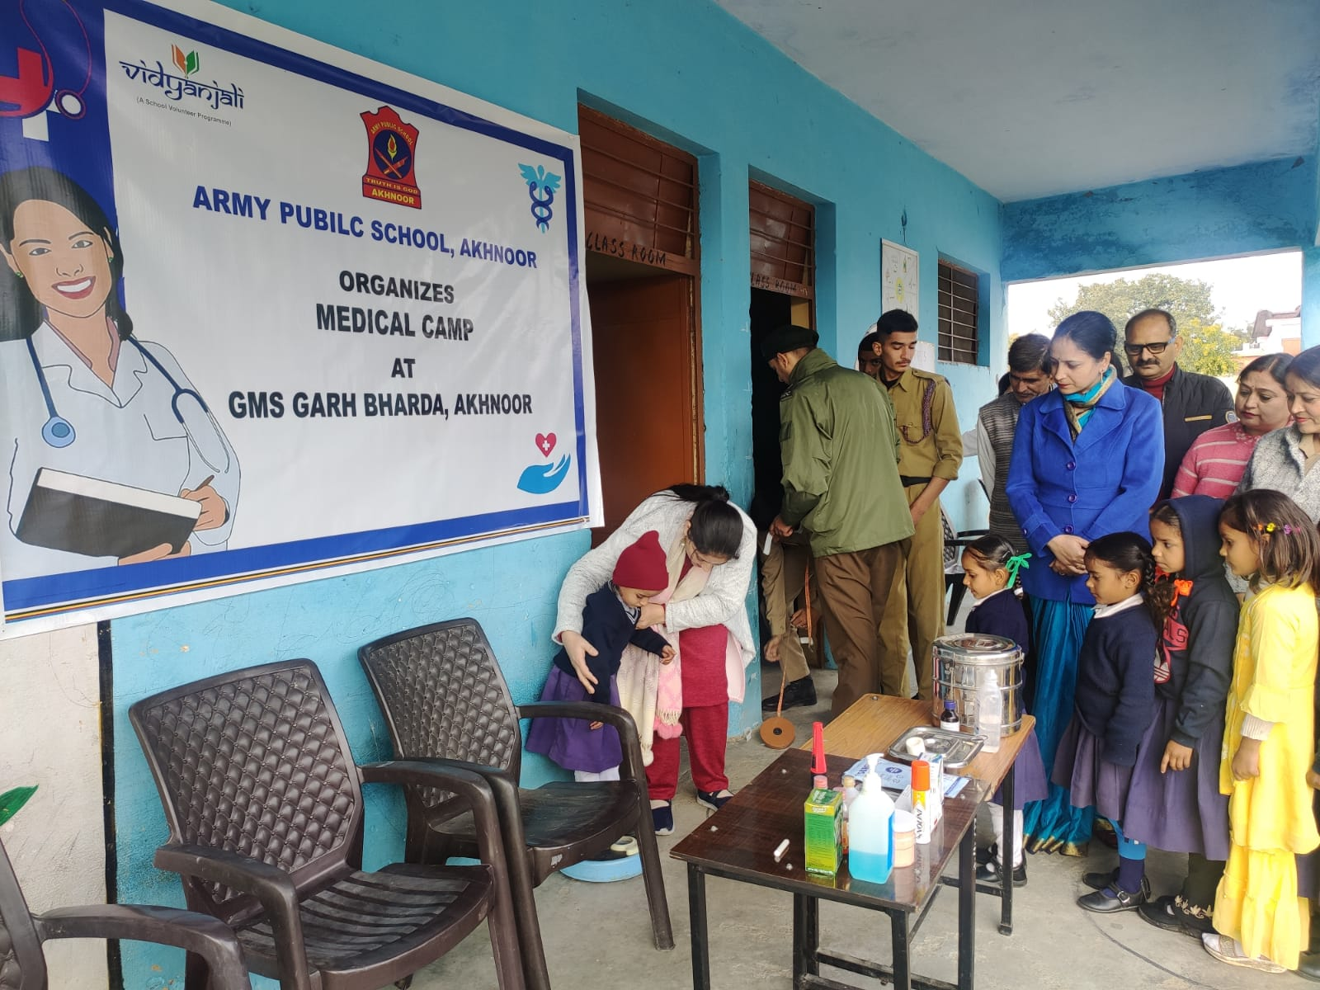
MEDICAL CAMP AT GMS GARH BHARDA UNDER VIDYANJALI PROGRAMME

Slide 4
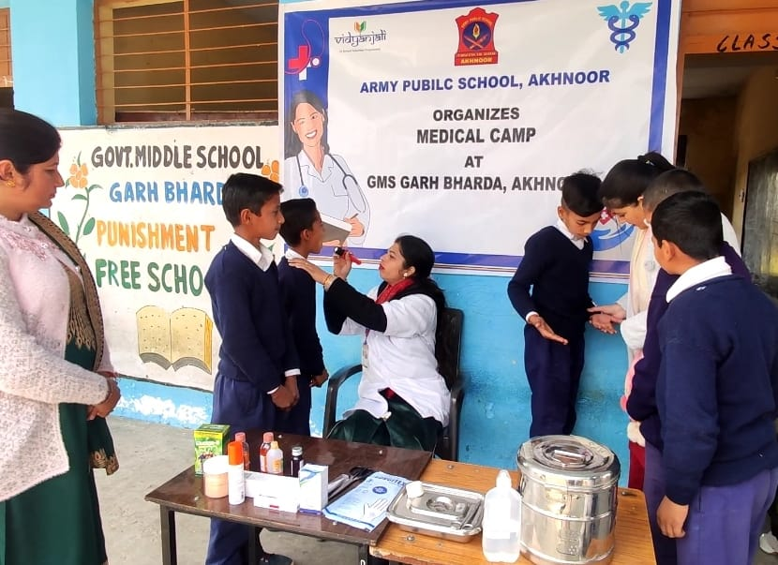
MEDICAL CAMP AT GMS GARH BHARDA UNDER VIDYANJALI PROGRAMME

Slide 5
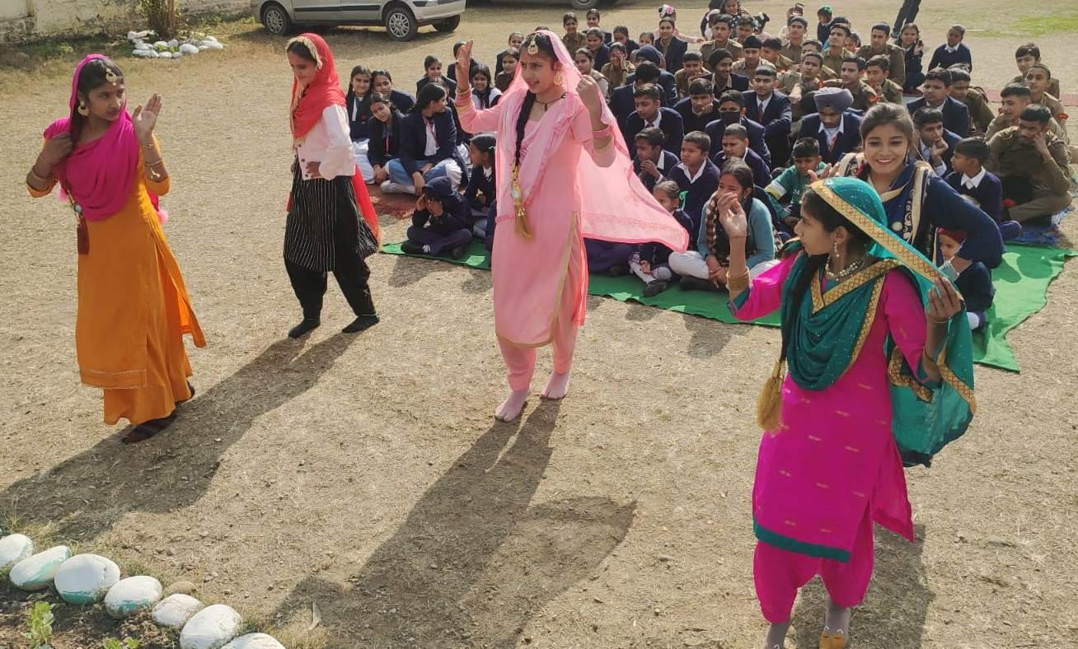
CULTURAL PROGRAMME AT GMS GARH BHARDA UNDER VIDYANJALI PROGRAMME

Slide 6
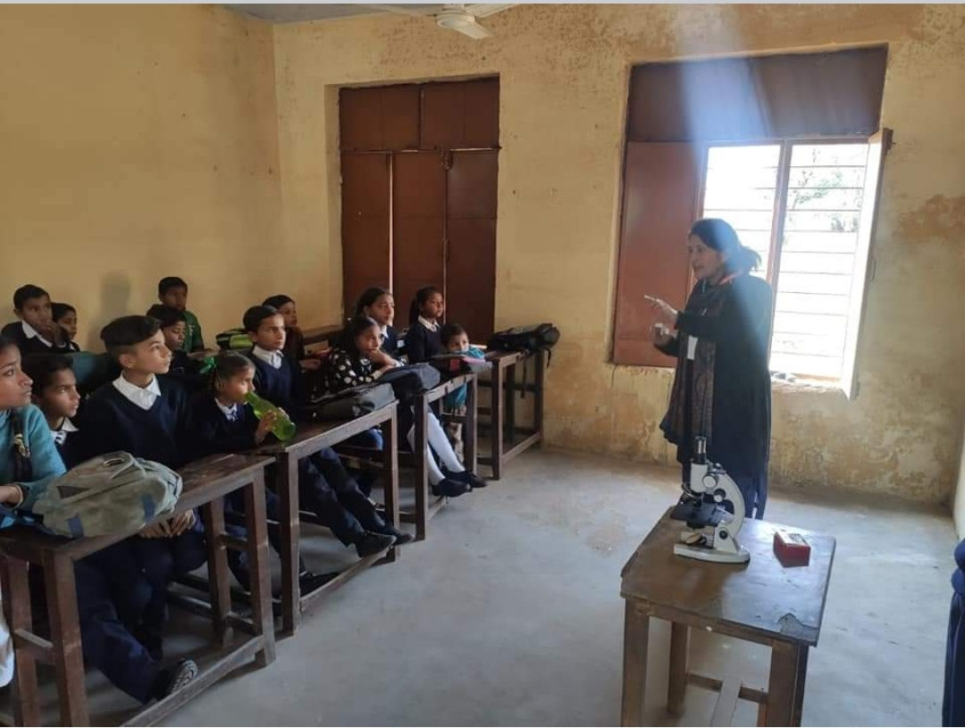
TEACHER EXCHANGING AT GMS GARH BHARDA
UNDER VIDYANJALI PROGRAMME

Slide 7
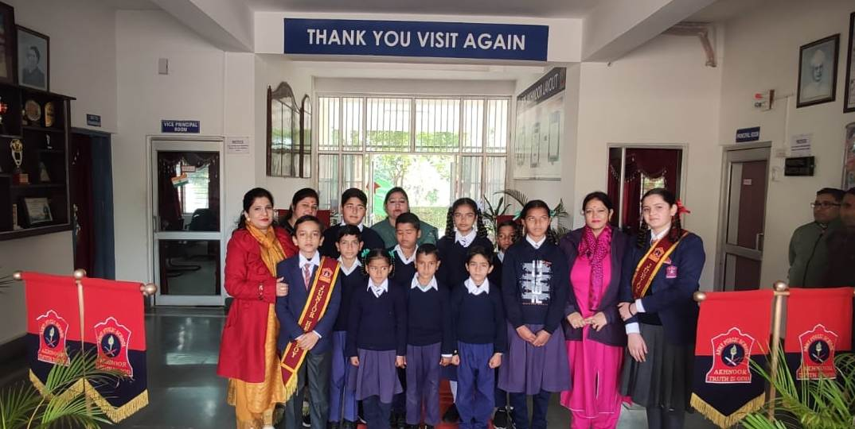
APS AKHNOOR WELCOMES GMS GARH BHARDA UNDER VIDYANJALI PROGRAMME

Slide 8
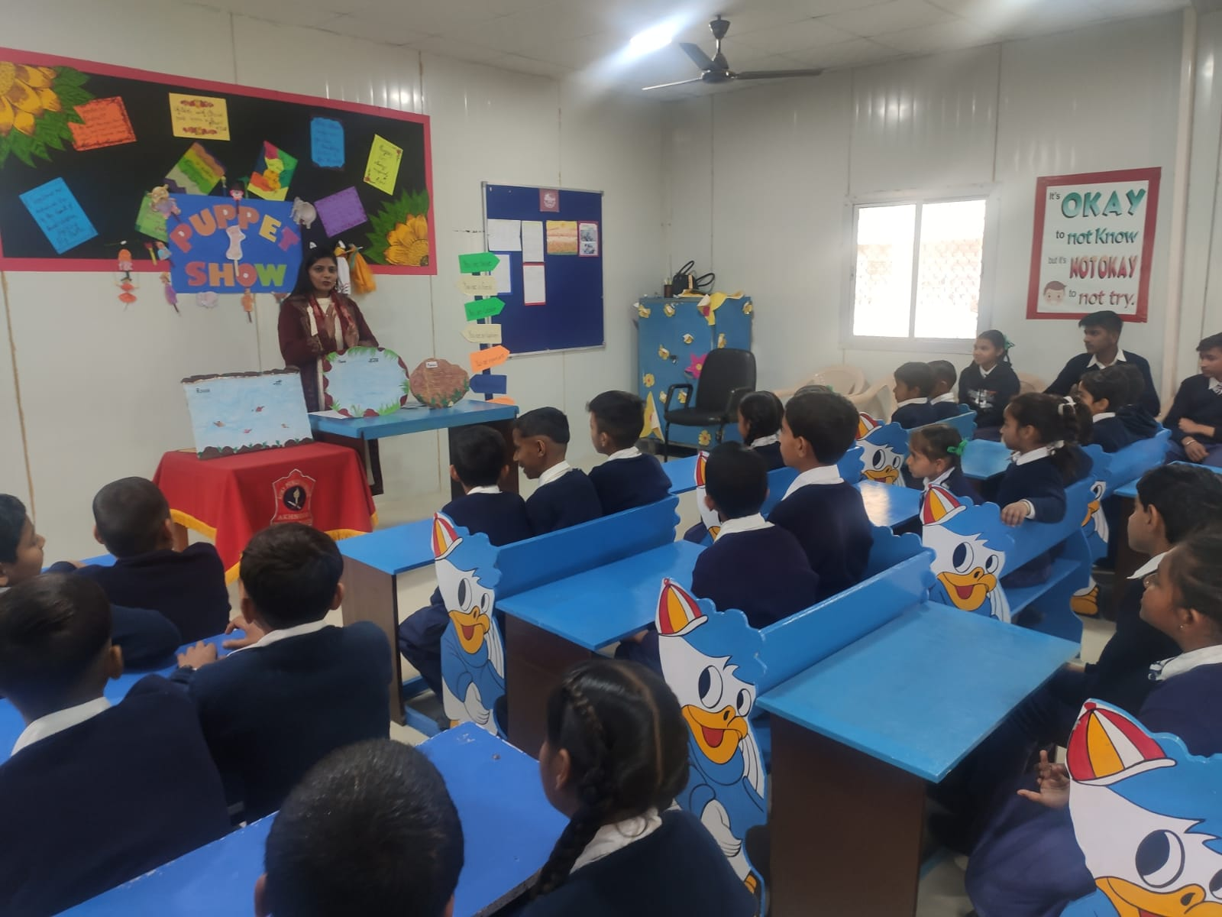
APS AKHNOOR WELCOMES GMS GARH BHARDA UNDER VIDYANJALI PROGRAMME

Slide 9
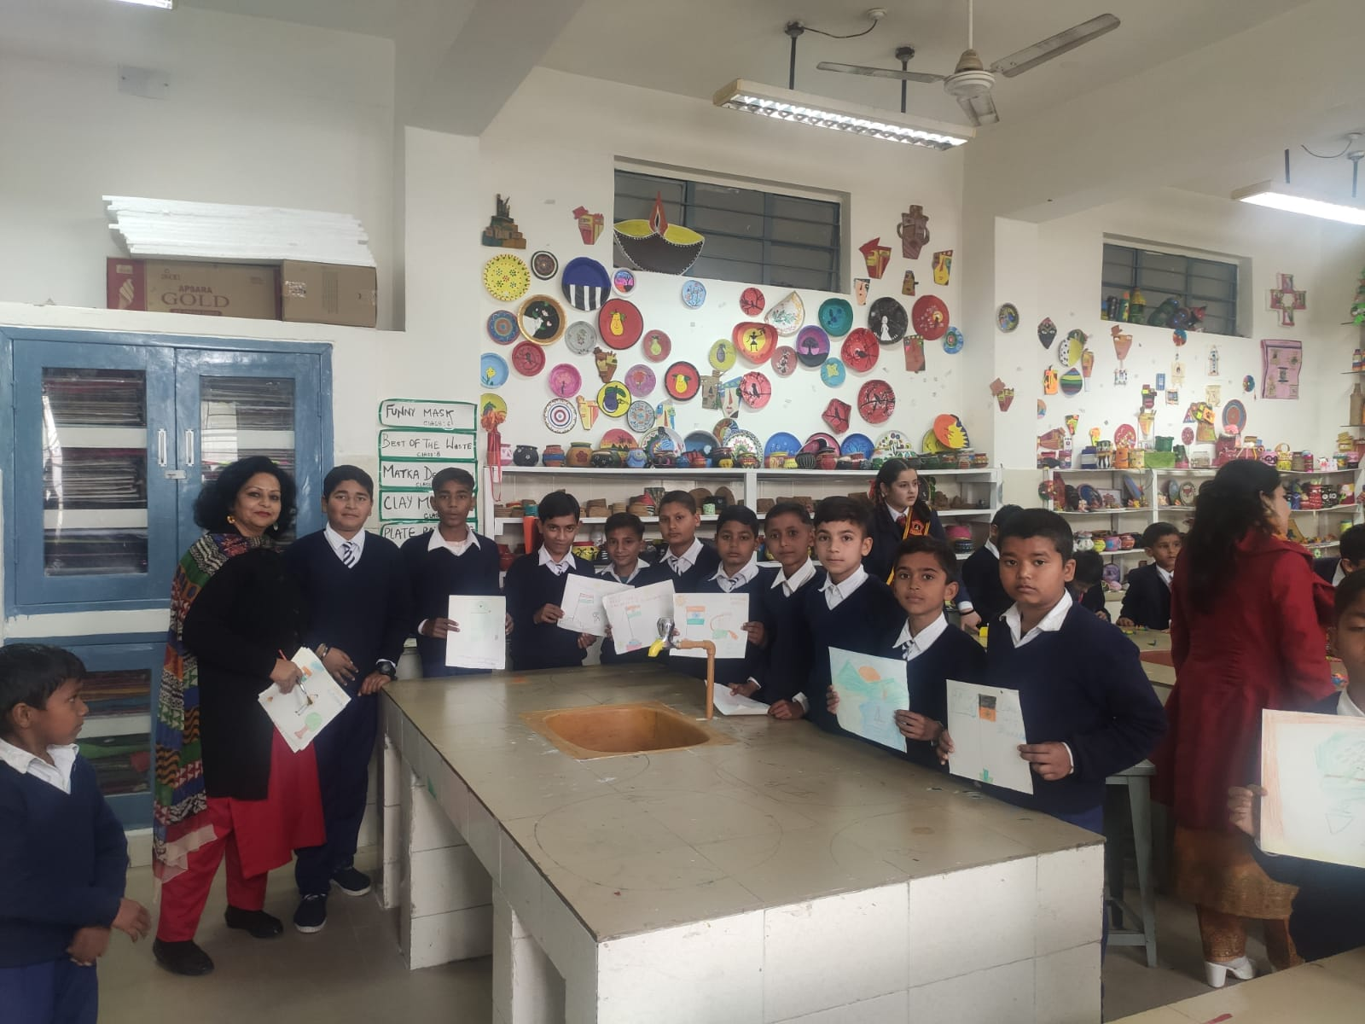
APS AKHNOOR WELCOMES GMS GARH BHARDA UNDER VIDYANJALI PROGRAMME

Slide 10
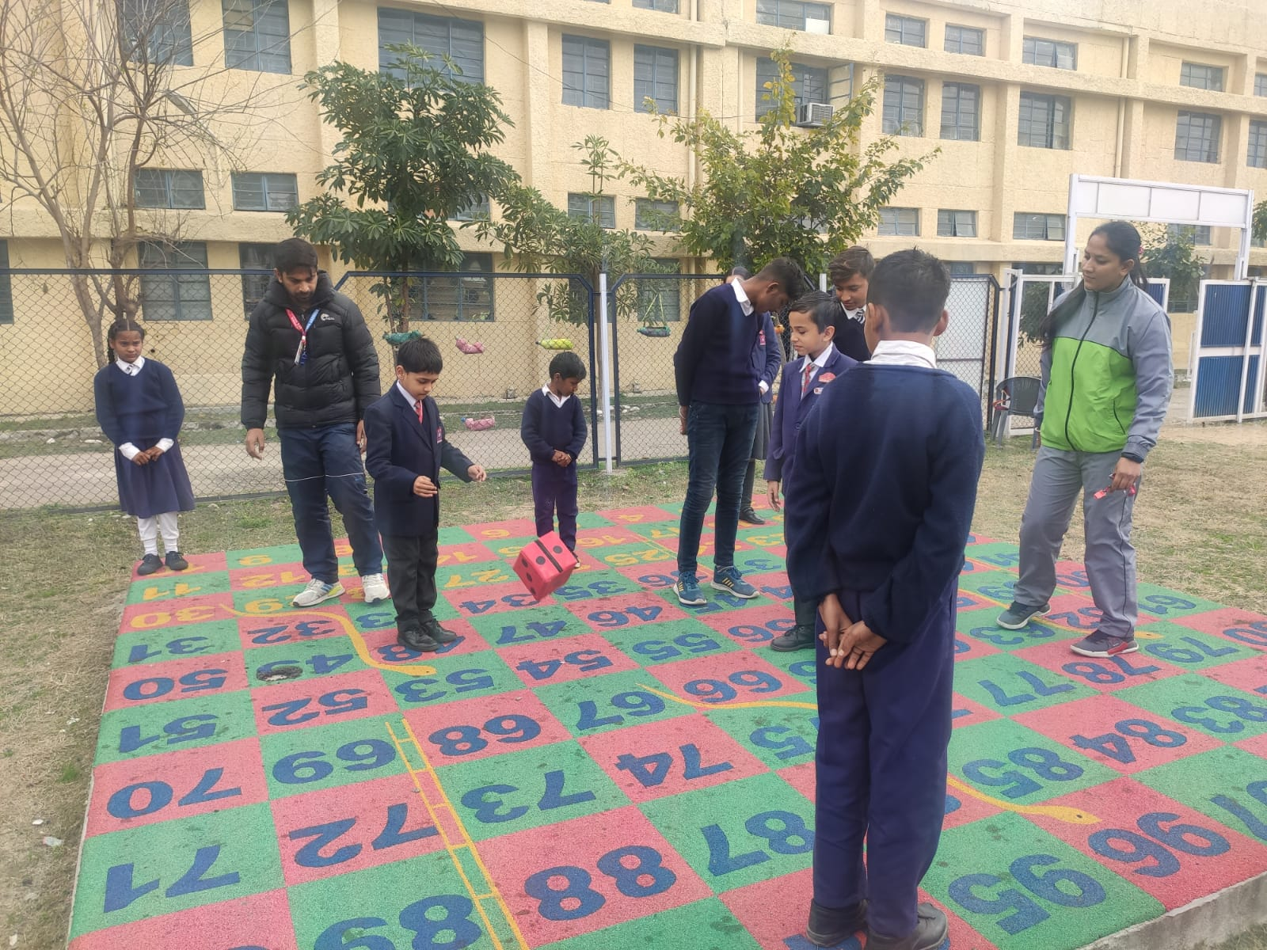
APS AKHNOOR WELCOMES GMS GARH BHARDA UNDER VIDYANJALI PROGRAMME

Slide 11
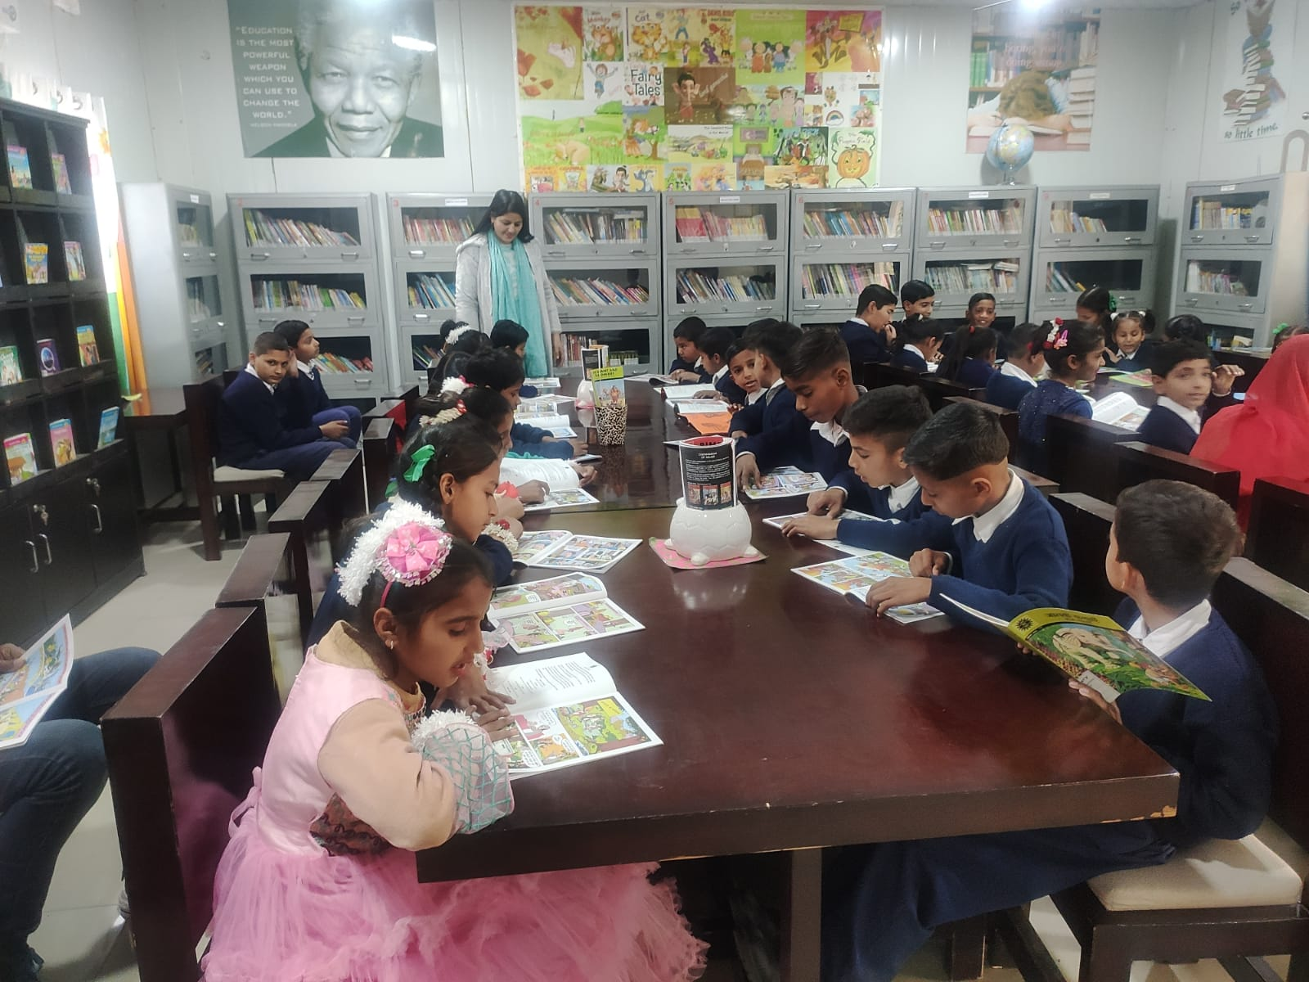
APS AKHNOOR WELCOMES GMS GARH BHARDA UNDER VIDYANJALI PROGRAMME

Slide 12
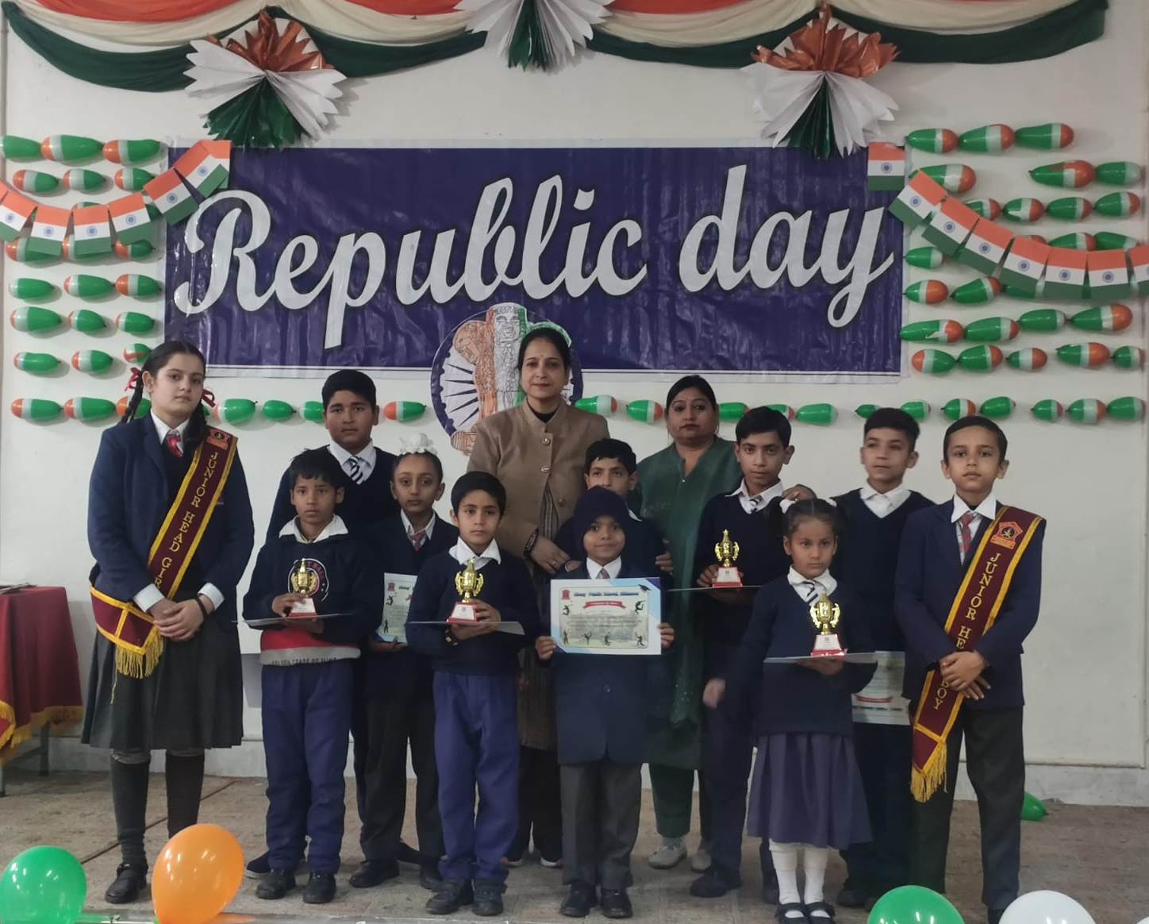
APS AKHNOOR WELCOMES GMS GARH BHARDA UNDER VIDYANJALI PROGRAMME

Slide 13
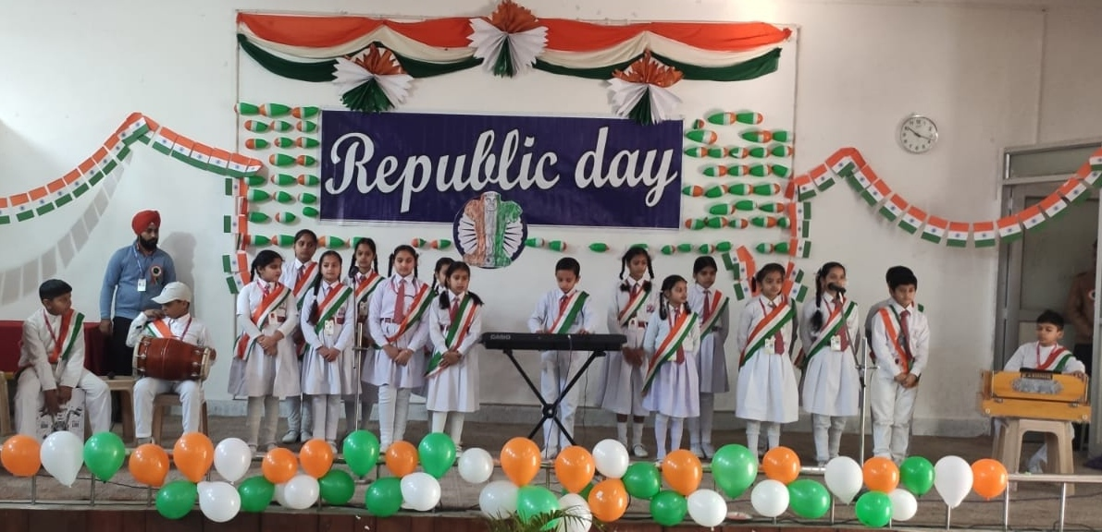
REPUBLIC DAY CELEBRATION

Slide 14
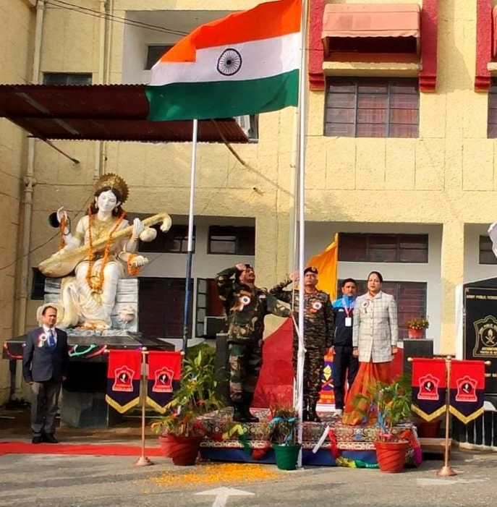
REPUBLIC DAY CELEBRATION

